Slide 1
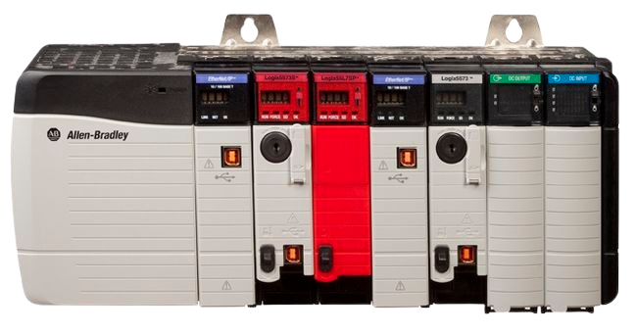
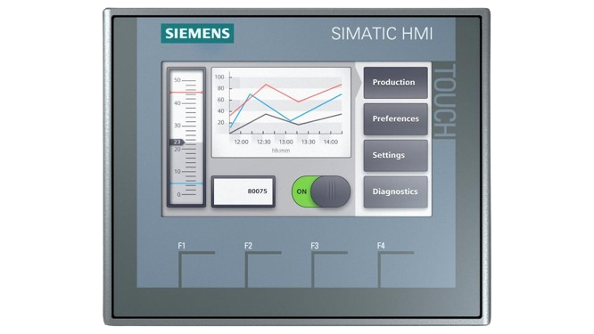
CONTROLS AND AUTOMATION ENGINEERING CRASH COURSE
Episode 1 – Introduction to Automation and Controls Engineering

Slide 2
COURSE FORMAT
Episode 1 – Introduction to Automation and Controls Engineering
Episode 2 – How a Controls and Automation Project Works
Episode 2 – Basics of PLC Programming
Episode 3 – HMI (GUI) Development and SCADA
Episode 4 – Controls Hardware and Basics of Panel Design
Episode 5 – Industrial Networking
Episode 6 – Historian, SQL, MES, and Data Reporting
Episode 7 – Remote IO, VFDs, IO-Link and PLC to PLC messaging
Episode 8 – Miscellaneous Things to Keep In Mind

Slide 3
By the end of the course, You SHOULD…
Have an excellent understanding of what this field is from what tools and technologies are used, to how a typical project is run start to finish
Understand what companies and industries are looking for these engineers
Know what skills would be expected of you in this industry, and ways to develop them for free/very cheap
Be able to decide if pursuing a career in this field would be interesting and engaging for you
Know good places to get more information to further your education on the subject

Slide 4
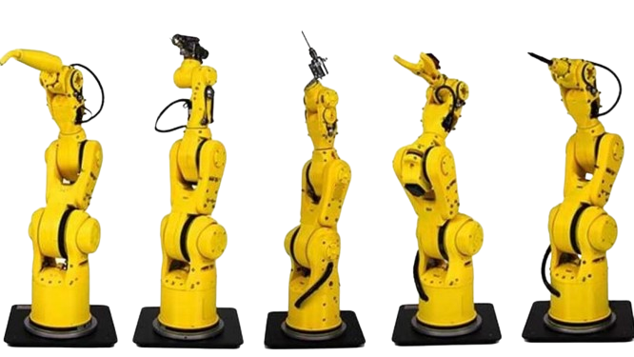
Episode 1 – Introduction to Automation and Controls Engineering
What Automation and Controls Is
Primary Tools and Technologies Used
Industries that Need Automation
Education “Required”
Career Paths/Related Fields
Salary Ranges
Free Resources for learning more about the field

Slide 5
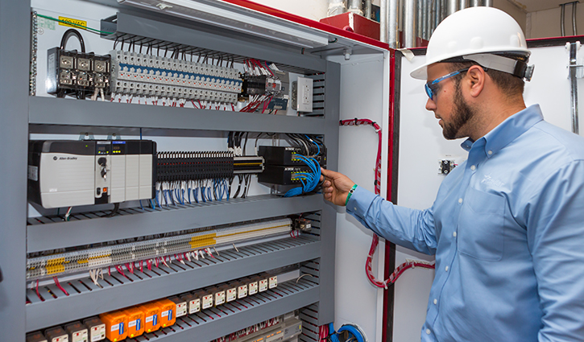
In A FEW SENTENCEs… What IS Automation and Controls?

Slide 6
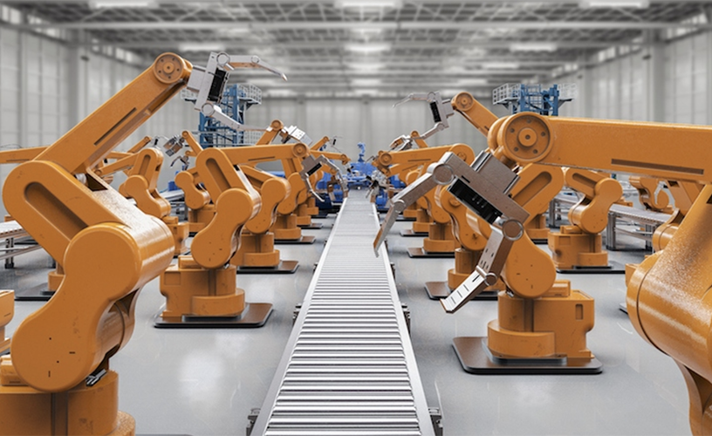
The field OF ENGINEERING PERTAINING TO IMPROVEMENTS TO A PROCESS by INCREASING THROUGHPUT and MANUFACTURING SPEED, INCREASING SAFETY AND SYSTEM RELIABILITY, OR BOTH. This is most commonly achieved BY WRITING code for dedicated Industrial Computers known as Programmable logic controllers (PLCs) that control Input and Output devices (IO) and often interface with engineers and operators through a Human Machine Interface (HMI).
What IS Automation and Controls?

Slide 7
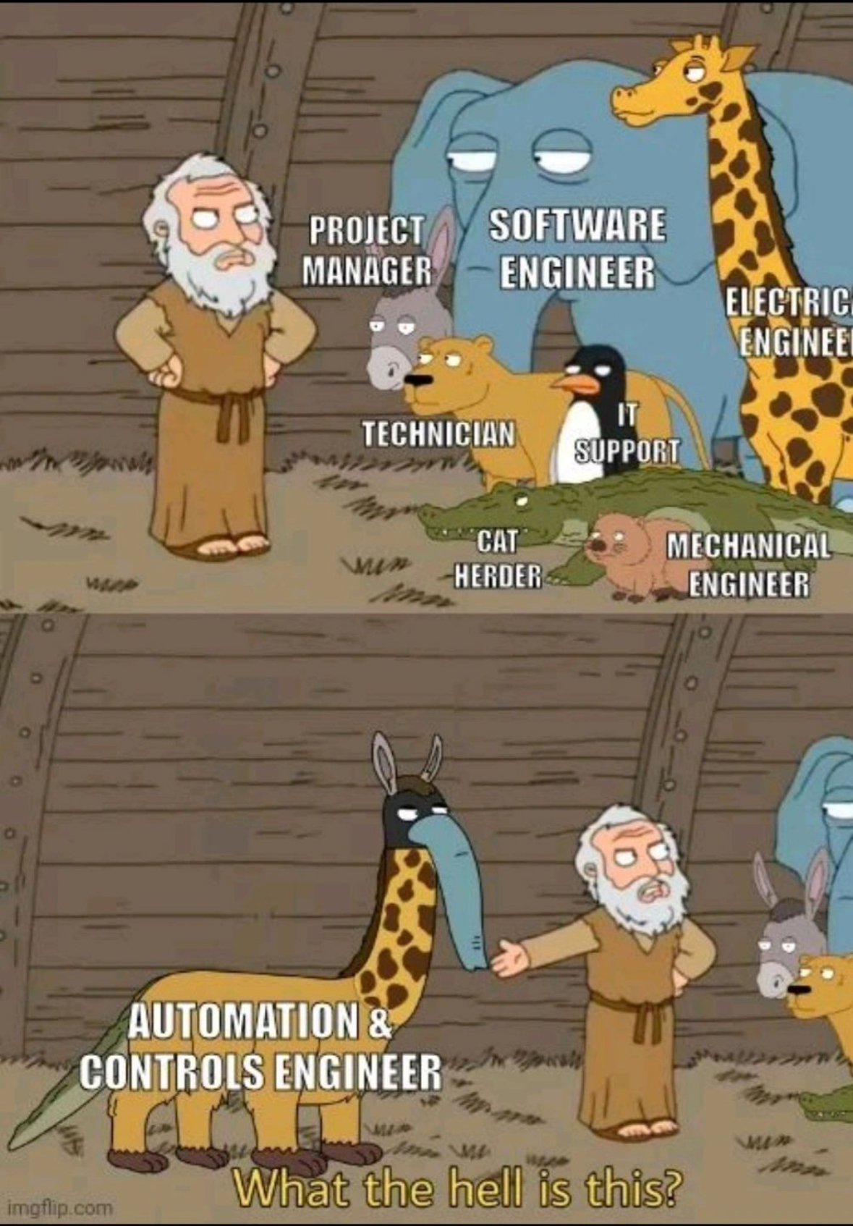
SO… WHAT ARE YOU?
Enough Mechanical/Chemical Knowledge to understand the process you’re controlling/improving
Enough Electrical Engineering Knowledge to design safe and effective control panels, and wire hardware
Enough Computer Science Engineering to write clean easy to follow PLC code and effective and practical HMI Graphics
Enough IT knowledge to be able to construct reliable industrial networks
You don’t need to enter the field with all of these skills, you just need to be open to learning and adapting

Slide 8
KEY TECHNOLOGIES
And Tools of the Trade

Slide 9
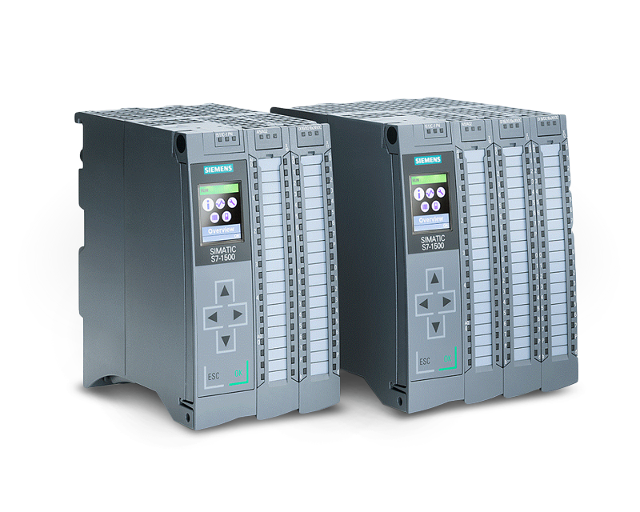
THE PROGRAMMABLE LOGIC CONTROLLER (PLC)
- While some industries are exploring Industrial PCs, and others are controlling small system with Microcontrollers, the PLC remains the dominant ‘brain’ driving controls an automation worldwide.
There are MANY manufacturers of PLCs and PLC hardware, but some of the largest in the world are Rockwell/Allen-Bradley, Siemens, and ABB.
A PLC is a specific type of computer optimized for high reliability, synchronous programming, and converting coded commands to electrical signals to control output devices, and reading electrical signals back in from devices as inputs
Specific Programming Languages (IEC-61131) exist to write the code for these PLCs, and the most common two are Ladder Logic and Structured Text

Slide 10








Input and OUTPUT Devices (IO)
There are only 2 types of input and output signals when you REALLY break it down.
Digital Inputs and Outputs. AKA discrete/on-off/Boolean/binary – think light switch or simple light bulb
Analog Inputs and Outputs. AKA variable range/ 0-100% /position control – think dimmer switch or battery reading
While saying those are the only two is a big simplification, the many variations that exist in the field are combinations/extrapolations on this idea.
Devices now are often smart enough to have embedded communications protocols allowing for passing of a lot of data via serial, ethernet or a similar advanced communications protocol, like VFDs or Load Cells/Scales
Determining which type and how many of these devices you’ll need, is the driving factor behind your whole hardware design

Slide 11
THE HUMAN MACHINE INTERFACE (HMI)
Some very simple systems may be completely controllable from a few pushbuttons or indicator lights, but the vast majority of complicated automation requires well designed HMI graphics.
Software developers may think of these as “GUIs”
Range from simple displays showing a few device statuses and text to massive factory wide graphical environments with thousands of tags
A Standalone HMI might be used to control one station/piece of equipment, and is usually just referred to as a station, a view, or just an HMI
A complicated graphical display environment showing many systems and subsystems and tying in many pieces of equipment and parts of a manufacturing line is usually a SCADA

Slide 12
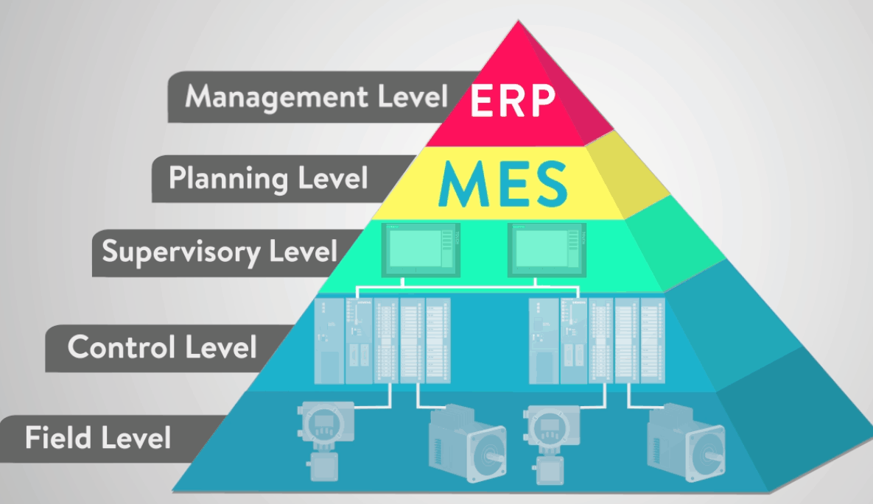
THE SUPERVISORY CONTROL AND DATA ACQUISITION (SCADA) (plus, the whole ‘automation pyramid thing’)
A Supervisory Control and Data Acquisition Software (SCADA) is very common at large plants or factories where many pieces of equipment can be shown in one integrated tool.
These often combine the functionality of an HMI with configurable security, embedded trending/SQL logging/and data monitoring or Historization
While technically the middle layer of the ‘Automation Pyramid’ its not uncommon for this to be the top layer a controls and automation engineer regularly develops in and works on
ERP and MES systems may require ACE resource input, but are often much more scheduling/inventory tracking/quality monitoring, and less automation focused
Valves/Pumps/Motors/Sensors – Field Level
PLCs + Drives/Smart IO + Local HMIs – Control Level

Slide 13
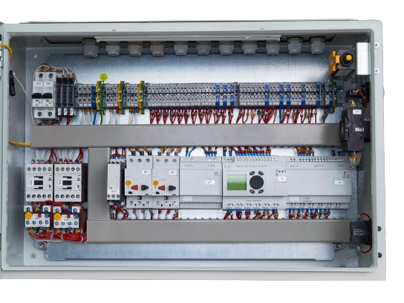
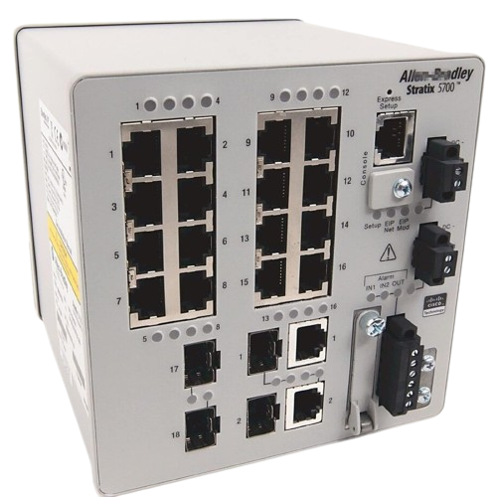
OTHER THINGS TO KNOW, BUT We're not deep diving YET
Industrial Networking Standards and Protocols
Basics of Servers, Operating Systems, and Computer Communications
Industrial Control Panel Design and Electrical Schematics
Data Reporting and Logging
There’s so much more, but not for lesson one!

Slide 14
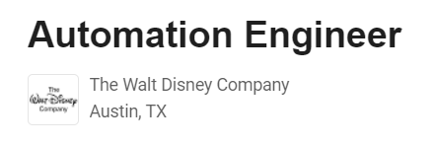




So, I know WHAT IT IS, BUT WHERE COULD I WORK?
Spend a little time on LinkedIn looking at jobs for controls and automation! Everyone needs these resources!
Automation is rapidly growing and every industry from high-speed manufacturing to chemicals and oil and gas to pharmaceuticals and even space travel and amusement parks need automation engineers. It is a beautiful niche of highly in demand and rare to find skilled resources.

Slide 15
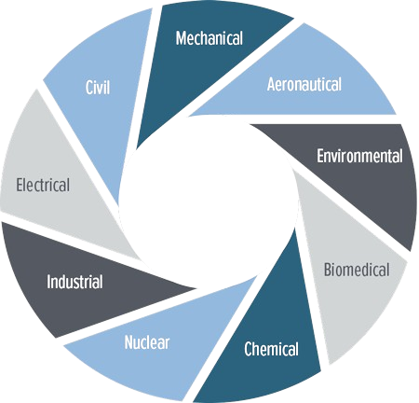
I’m HEADING TO SCHOOL, WHAT SHOULD I LEARN
PERSONALLY, I advise getting a broad engineering degree (Mechanical, Electrical, Computer Science) and choosing electives, doing projects, and looking for internships in this field
More flexibility should you want to change career paths. Few places hiring for controls would reject a well rounded, motivated individual
Most places are looking for individuals with a 4-year engineering degree, but many are willing to consider motivated and driven folks with practical skills and experience.

Slide 16
WHAT DOES A COMMON CAREER LOOK LIKE?
Two most common career paths – Integrator and Internal Resource
Integrators – larger dedicated teams of controls engineers typically operating as engineering contractors for companies with insufficient resources to take on big automation initiatives internally
These organizations often promote from within and are almost all technical, therefore its normal to see engineers able to get to project manager/manager/director and even VP type roles over time
Internal Resources – often only one or two automation resources on a larger technical team supporting a company from within.
These organizations could be larger and broader with levels of bureaucracy and business-type management above you, so starting pay/mid-career pay may be higher, but long term could stall earlier

Slide 17
SALARY RANGES (In the US – Numbers in USD$) not estimating for bonuses or other benefits
Stage Of Career | Average $ | Low-End | High-End
Internship/Co-Op | $20/hr | $16/hr | $25/hr
New Full-Time Hire | $70,000 | $50,000 | $90,000
5-10 Years Technical | $90,000 | $80,000 | $130,000
10+ Years Still Technical | $110,000 | $95,000 | $180,000
10+ Years Management | $140,000 | $110,000 | $200,000

Slide 18
SOME FREE AND CHEAP WAYS TO LEARN MORE
Real Pars YouTube Channel: https://www.youtube.com/@realpars
(The biggest and best free YT resource for controls topics)
Brilliant.org (Awesome fun app for learning all types of engineering concepts!)

